Slide 1

ECE201R01 : Microprocessor & Microcontroller Unit I: Architecture Types

Slide 2
Various Architectures
Architectures
Von Neumann
Harvard
CISC - Complex Instruction Set Computers
RISC - Reduced Instruction Set Computers

Slide 3
Based on Bus Architecture
CPU
Code
Memory
Data bus
Data bus
Data
Memory
Address bus
Address bus
Control bus
Control bus
Harvard architecture
Code
Memory
Data
Memory
CPU
Data bus
Address bus
Control bus
Von Neumann architecture

Slide 4
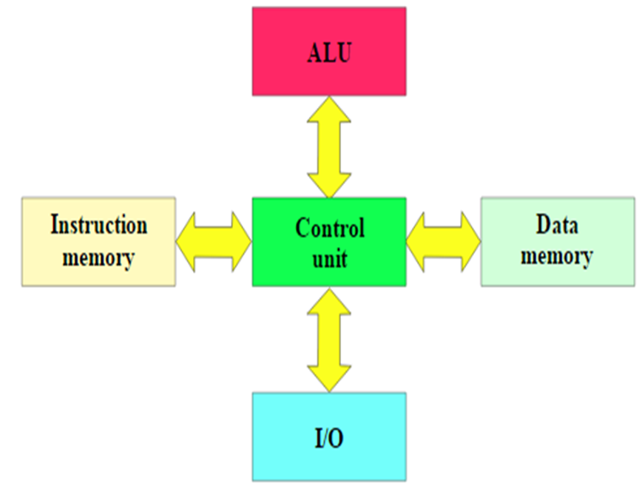
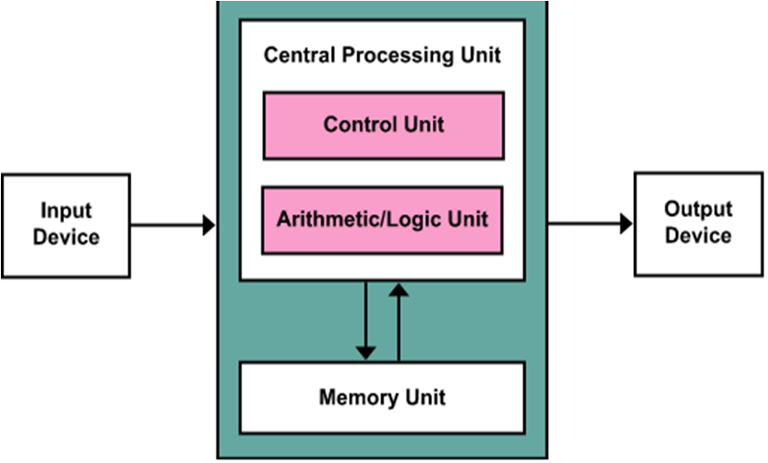
Based on Bus Architecture
Harvard Architecture
Von Neumann Architecture

Slide 5
Based on Bus Architecture
Harvard Architecture | Von Neumann Architecture
Instructions and data are stored in two physically separate memories namely instruction memory and data memory | Instruction and data memory are stored in the same system memory
There is a separate system bus to access instructions from the instruction memory and a separate system bus to access the data memory | Common system bus to access the instructions and the data from the system memory
CPU can read both the instruction and data from memory at the same time | Instruction fetching and data read/write cannot happen parallelly

Slide 6
Based on Instruction Set
CISC (Complex Instruction Set Computers) | RISC (Reduced Instruction Set Computers)
Complex instructions taking multiple cycles | Simple instructions taking one cycle
Variable length instructions | Fixed length instructions
Complexity is in the microprogram | Complexity is in the compiler
Emphasis on hardware | Emphasis on software
Many addressing modes | Few addressing modes, mostly register to register
Most of instructions may refer memory | Very few instructions refer memory
Memory-to-memory: "LOAD" and "STORE“ incorporated instructions | Register to register: "LOAD" and "STORE“ are independent instructions
Single register set (Fewer registers) | Multiple register sets (More registers)
Small code sizes & high cycles per second | Low cycles per second & large code sizes
More number of Instructions | Fewer number of Instructions

Slide 7
Thank you . . .

